Slide 1
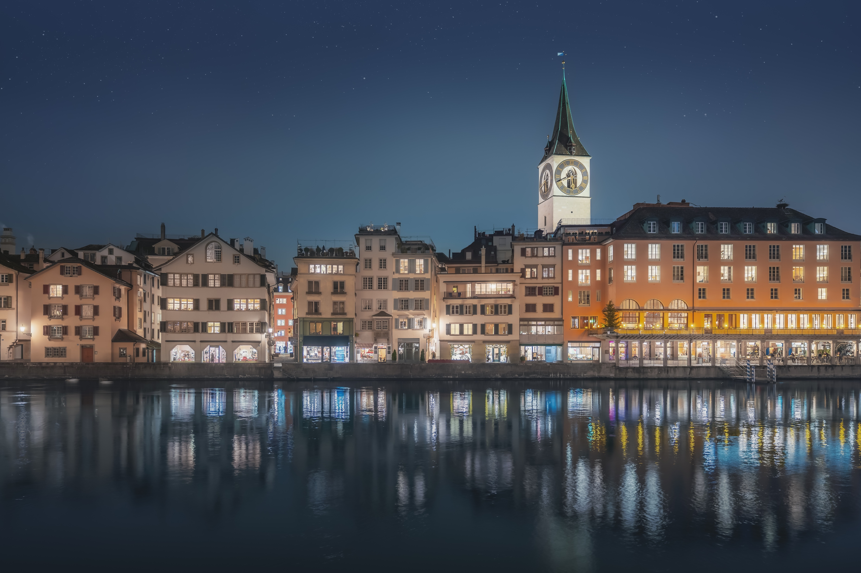
JCI WORLD CONGRESS
14. – 18. November 2023
ZÜRICH SWITZERLAND
#JCIWC2023

Slide 3
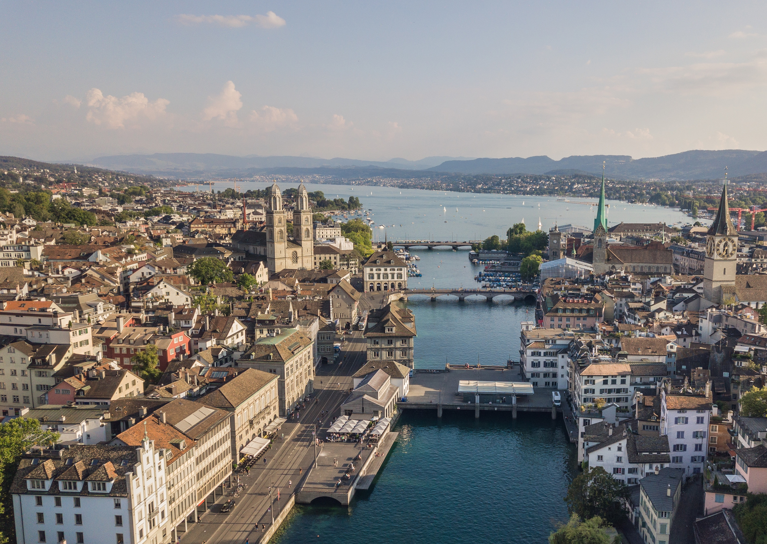
Welcome to Zürich & Switzerland
01

Slide 4
Zürich – Facts & Figures
Zürich is the largest city in Switzerland with a population of over 428’700. 1,4 million people live in Zürich agglomeration.
One out of every eleven jobs in Switzerland is in the City of Zürich. The financial sector provides approximately 16% of all employment in the City. The creative economy accounts for about 11%.
Buying bottled water is a waste of money in Zurich. Switzerland is one of the countries with the cleanest drinking water! In Zurich there are over 1,200 drinking fountains on almost every corner of the city.
Zurich is a hot spot for research and development. Google has their largest European office in downtown Zurich. Disney Research is located just a few minutes from Zurich’s center.
Millions of people fill the streets of Zurich to party at Street Parade every year on a Saturday in August, the largest techno parade in Europe.

Slide 5
Zürich – How to get there? These airlines bring you to Zurich
Aegean Airlines
Aer Lingus
Aeroflot
Air Baltic
Air Cairo
Air Canada
Air Europa
Air France
Air Malta
Air Montenegro
Air Serbia
Alitalia
Austrian Airlines
British Airways
Bulgaria Air
Cathay Pacific
Chair Airlines
Condor
Corendon Airlines
Croatia Airlines
Cyprus Airways
Delta Air Lines
EasyJet
Edelweiss
EL AL Israel Airlines
Emirates
Ehihad Airways
Eurowings
Finnair
Helvetic Airways
Iberia
Icelandair
KLM
Korean Air
LOT Polish Airline
Lufthansa
Oman Air
Pegasus
Qatar Airways
Royal Air Maroc
Royal Jordanian
SAS Scandinavian Airlines
Singapore Airlines
SunExpress
Air Portugal
Thai Airways
Thai Airways
Tunisair
Turkish Airlines
United Airlines
Vueling

Slide 6
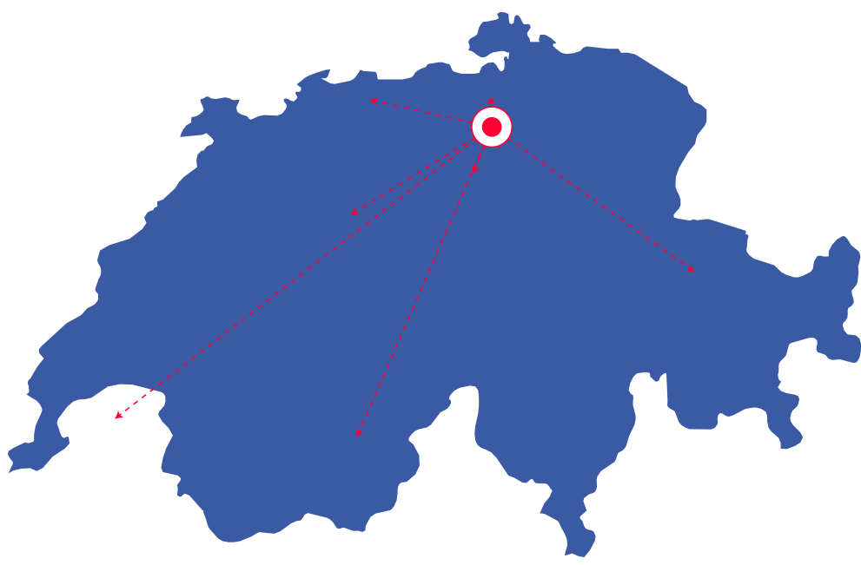
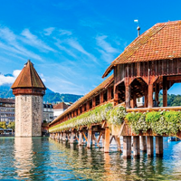
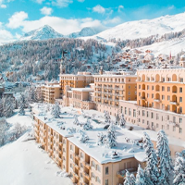
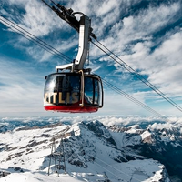
Switzerland Stunning sights nearby
GERMANY
Rhine Falls 1.5h
Basel 1h
*Travel times calculated with public transport
FRANCE
Lucerne 1h
Bern 1h
Titlis 2h
St. Moritz 3h
Geneva 3h
ITALY

Slide 7
Switzerland We have a lot to offer
GERMANY
Zoo
Waterfalls
FRANCE
Traditional Farming
Cheese
Chocolate
The Alps
Pocket Knives
ITALY

Slide 8
Switzerland – Visa requirements
Visa applications
For some country a visa is required. Find more information under www.swiss-visa.ch
Only short-term visa applications (up to 90 days, Schengen visa) such as tourist, visit or business can be submitted online. A visa application can be submitted at the earliest six months before entering the Schengen area.
Where to apply for a visa?
Depending on your place of residence, you can submit your visa application either: directly at a Swiss representation abroad; by filling out the visa application online; at an external visa service provider; at the representation of another Schengen State (not possible in every case due to the pandemic).
If you need a confirmation that you are attending the congress, please contact us via visa@jci-wc23.ch

Slide 9
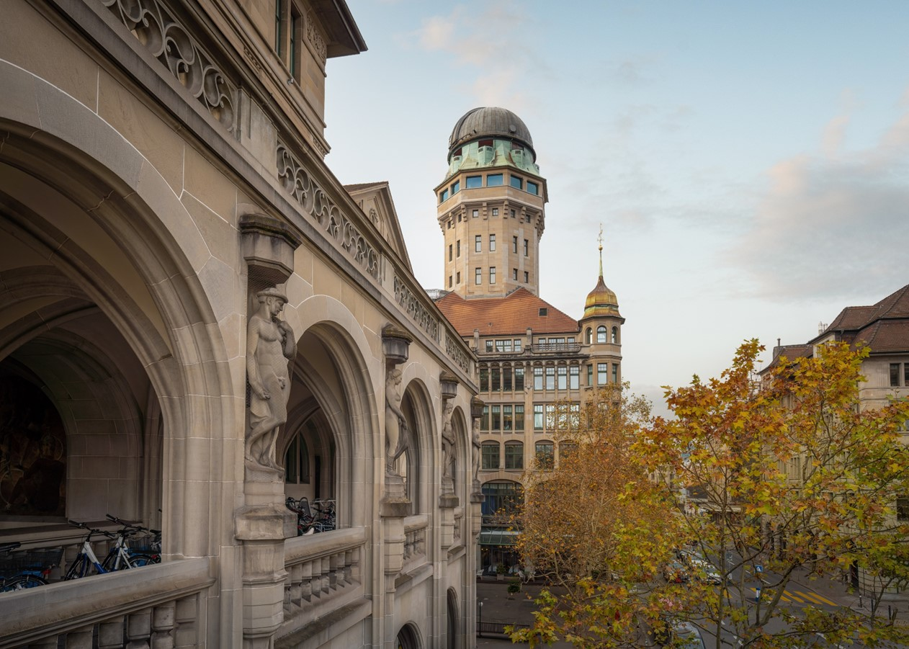
Convention Center
02

Slide 10
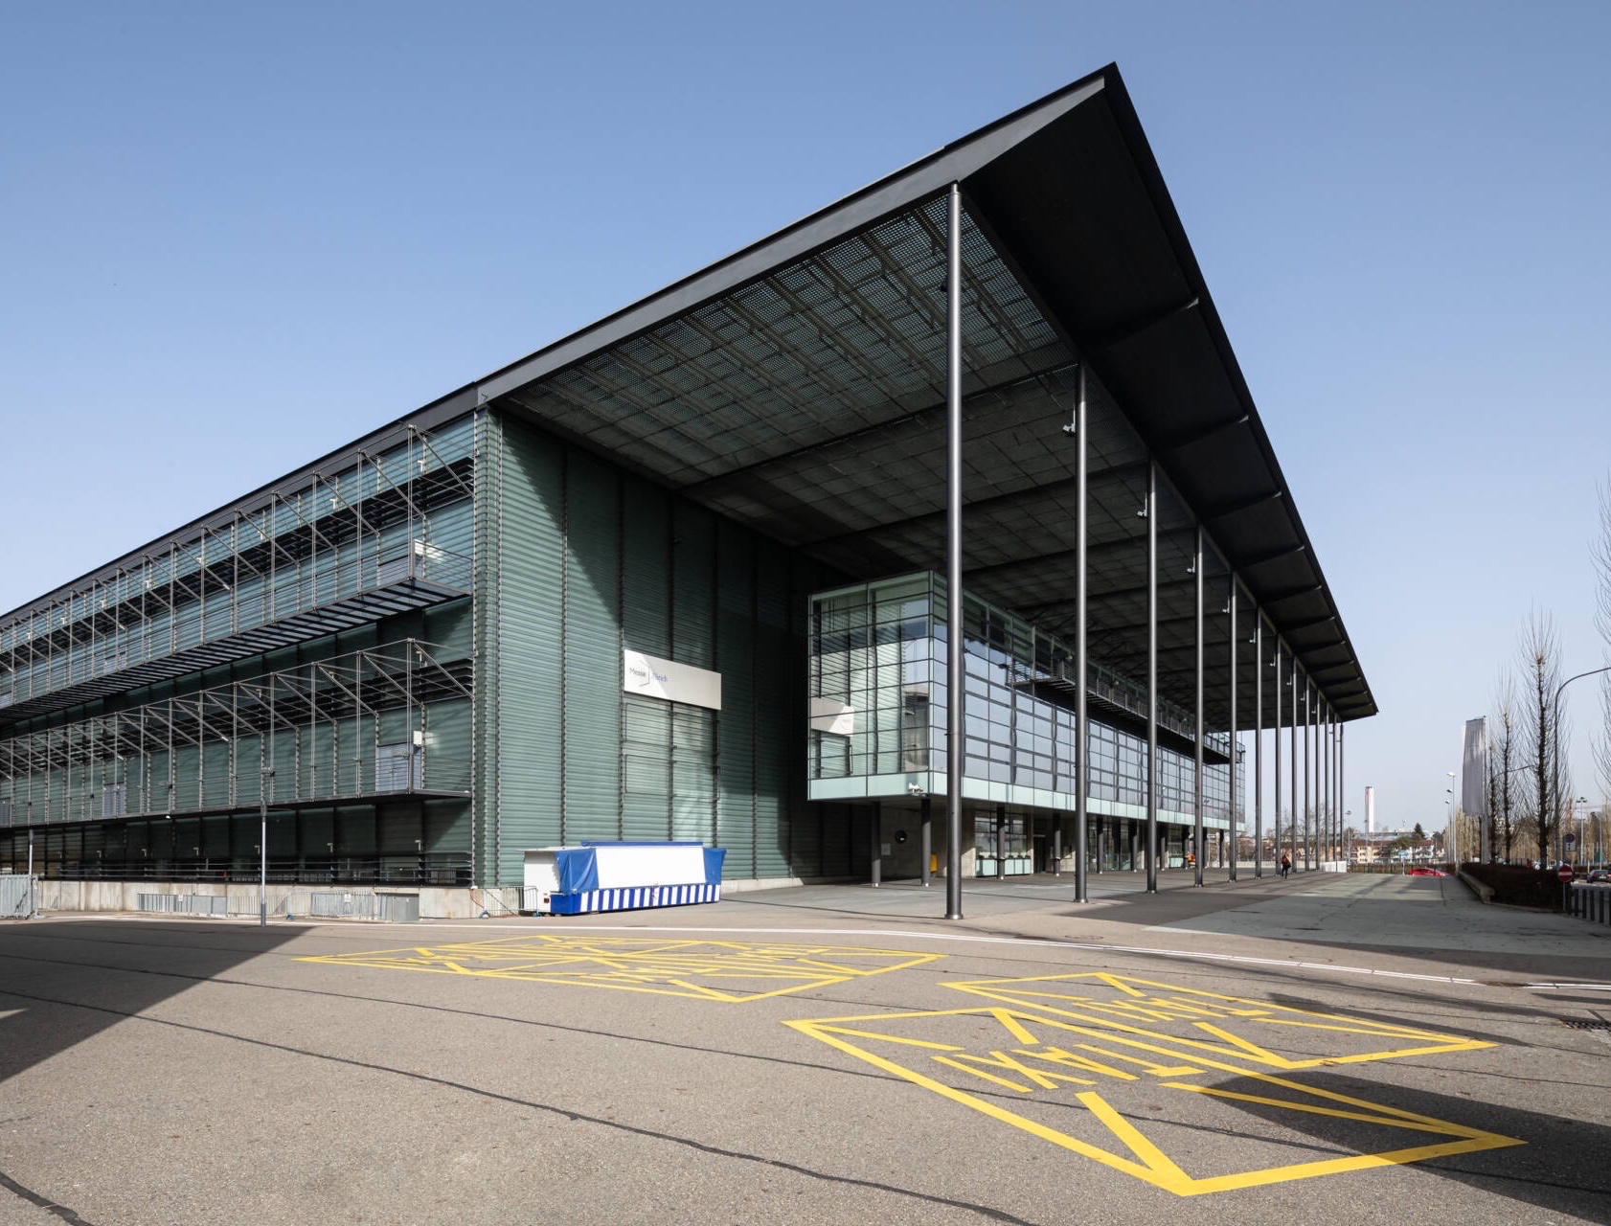
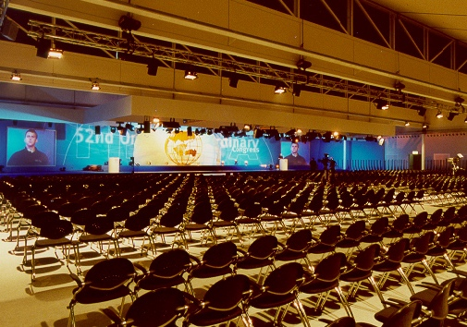
Convention Center Zürich
Zürich Exhibition Hall (Messe Zürich), Wallisellenstrasse 49, CH- 8050 Zürich

Slide 11
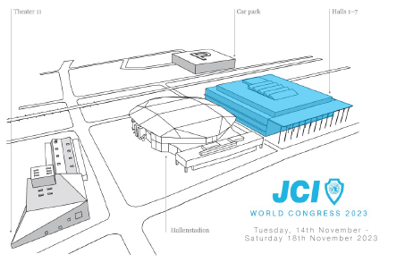
Convention Center Zürich
Easy to reach by public transport and car
10 min walk from Zürich Oerlikon train station
5 min walk from parking garage Messe Zürich
5 min by car from A1
15 min from Zurich Airport (Tram stop Messe/Hallenstadion)
Modern infrastructure
30'000 m² exhibition area
7 halls
7 conference rooms
690k visitors per year
280 events per year

Slide 12
Program
03

Slide 13
Congress Theme
Challenge the Present, create the Future
Arts, Culture & Education
Research & Technology
Green Economy, Mobility & Transport

Slide 14
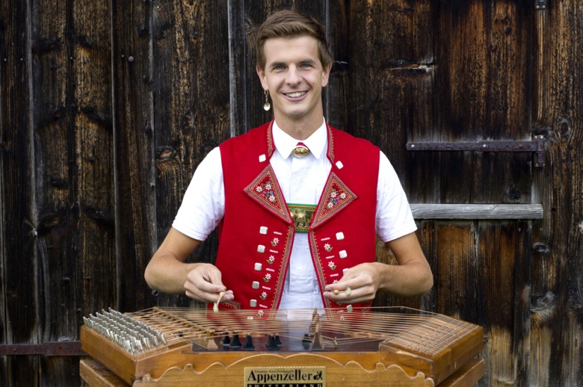
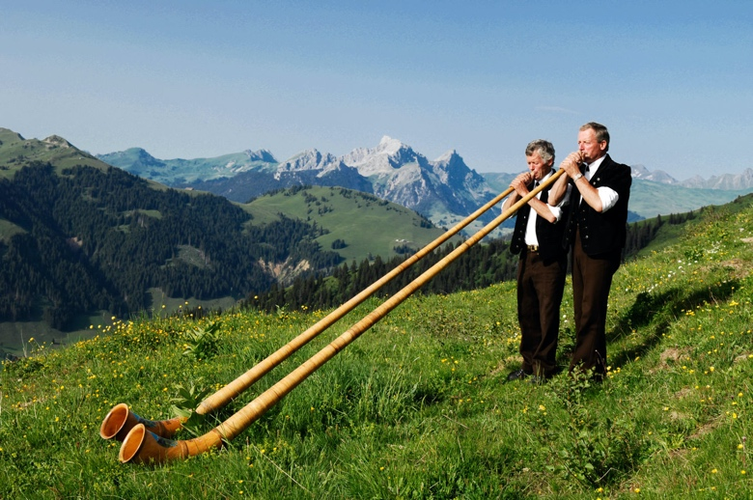
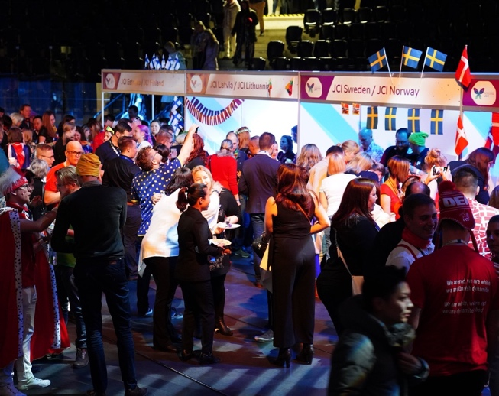
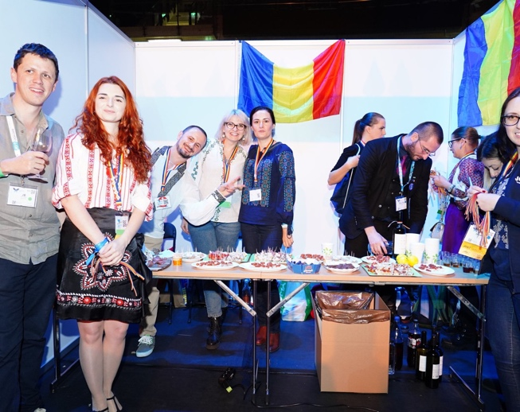
Program Highlights
Tue, Nov 14
Wed, Nov 15
Thu, Nov 16
Fri, Nov 17
Sat, Nov 15
Opening Ceremony & Swiss Night with Nicola Senn & Alphorn players, Party with DJ Timo Tetriz
National Night
Global Village Night
National Night
Gala Night with Luca Hänni

Slide 15
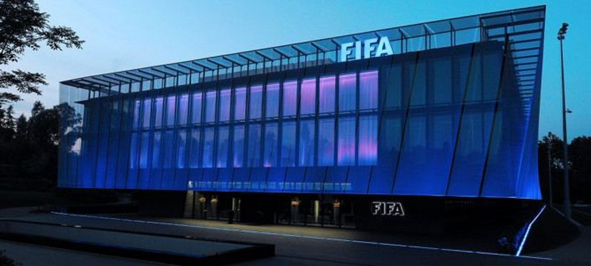
Leisure Program
Confirmed
In progress
Daily City Tours (EN/JP)
Daily Brewery Tours
Daily «Landesmuseum» Tours incl. Illuminarium
Daily Chocolate Tours (L&S)
Daily GinLab incl. Tasting
Excl. 1-Day Matternhorn Tour hosted by Sen. Hauri
JCI Football Worldcup
Zoo Zurich Tours
Morning sports
Victorinox Factory Visit
Ricola Factory visit
FIFA HQ visit
Visit Bucherer Swiss World of watches
E-Sports tournaments incl. FIFA and Sim-Racing
Environment day
Pretour Geneva-Zurich
Pretour Basel-Zurich

Slide 16
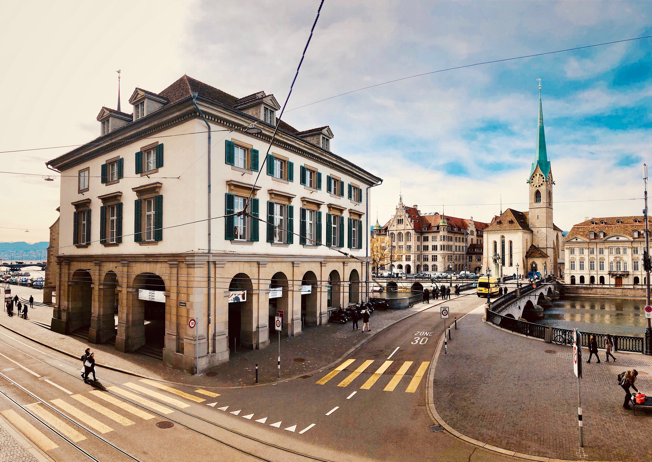
Global Village Night
04

Slide 17
Global Village Night
Facts
Thursday, 16th of November 2023
7 pm open doors and start Food & Beverage, 10 pm end Global Village and start party with a DJ
No costs for the booth, as you bring the food/drinks at your own costs
Booths will be provided, discuss with COC if you are planning to bring your own booth
Plates, bowls, cutlery and glasses will be provided
Power connection available
Dos & Don’ts
One sponsor board per booth (format A3-A1)
No water connection available
No gas or fire allowed!
NEXT STEP
Register your National Organization via e-mail program@jci-wc23.ch

Slide 18
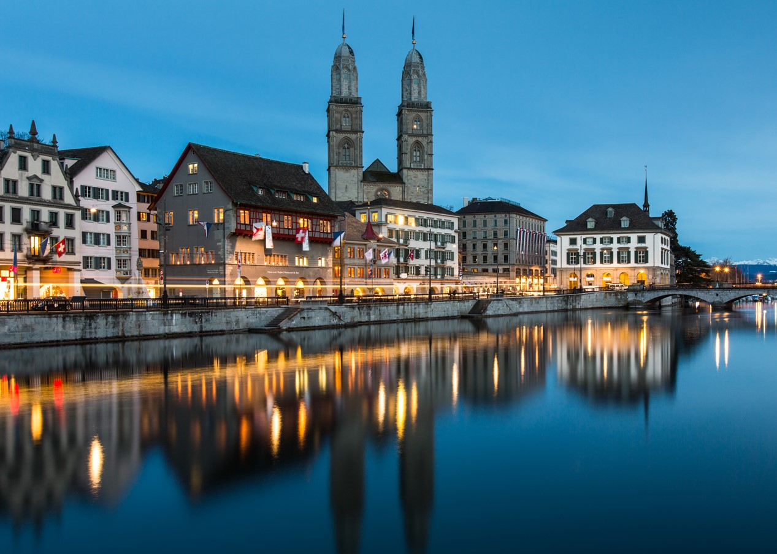
Hospitality
05

Slide 19
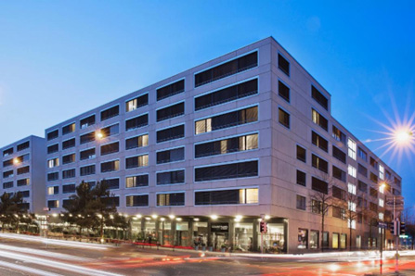
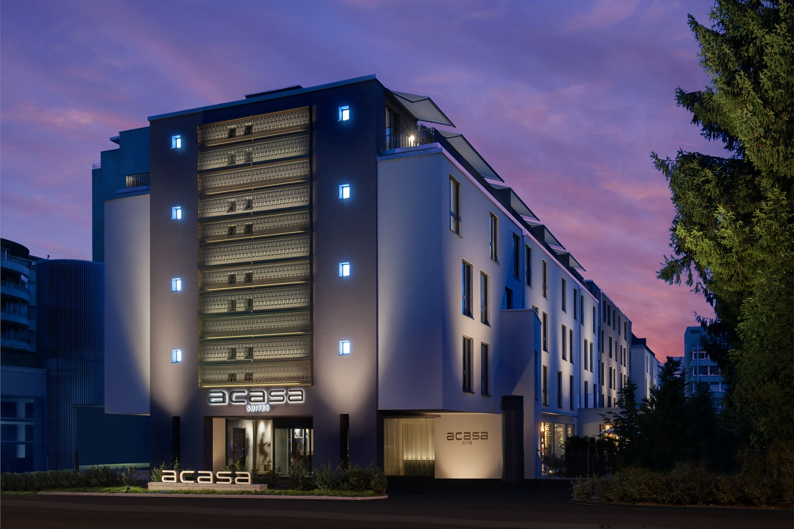
Hotels
A total of 2’800 rooms has been prebooked.
Courtyard Zurich North (HQ)
Acasa Suites (Senator's Hotel)
Single use: CHF 229.-
Double use: CHF 254.-
CHF 235.- Mon-Thu (per room/night)
CHF 210.- Fri-Sun (per room/night)

Slide 20
More Hotels
There is a list of recommended hotels:
https://www.jci-wc23.ch/accommodation-visa/
Zürich Tourism supports all inquiries and also group bookings
For further inquiries or requests we are at your disposal:
accommodation@jci-wc23.ch

Slide 21
Food Concept
Lunch-Check card with a credit of CHF 80.- for all participants (= CHF 20.- per lunch)
Around 10’000 restaurants accept Lunch-Check as a payment method (1’800 restaurants in Zürich) → ideal for day trips!
Lunch will be provided at Messe Zurich (self-pay / Lunch-Check)
Snacks will be provided during evening programs, we are working on a midnight snack as well (no full meals)

Slide 22
Tickets
06

Slide 23
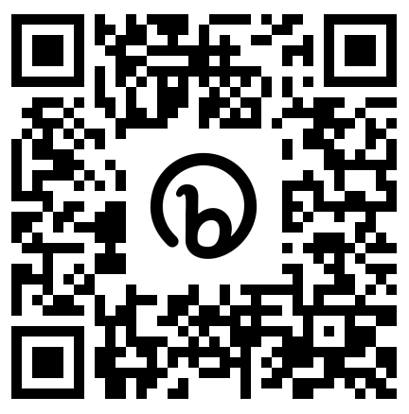
Ticket Sale is open
GET YOUR TICKET NOW
Regular Fee
Late Bird
$ 625.-
until 31. July 2023
$ 675.-
From 1. August 2023
jci-wc23.ch/ticketing

Slide 24
VIP Package
Unique advantages for a unique experience
VIP Package
Fast Lane Check-In
Personalized VIP badge & VIP hotline
Reserved front row seats for keynotes
Meet&Greet with selected keynote speakers and show acts in the VIP Lounge
VIP Lounge access (networking, snacks & drinks, warderobe)
Invitation to the sponsors & partners reception
Limited Edition: Only 100 VIP Packages available → Choose your number 1-100
CHF 400.-
(in addition to the ticket)
jci-wc23.ch/ticketing

Slide 25
Reasons to JOIN
07

Slide 26
Why should you join? What is in it for YOU?
First JCI World Congress in person since Tallin !
Ticket price = only 100 USD more than a ticket for the JCI European Conference, but the conference goes 1 day longer, i.e. 1 day more full of fantastic program and one more incredible party
Zurich = easy to reach from countries in Europe (cheaper travel costs than e.g. a WC in Asia or America)

Slide 27
Why should you join? What is in it for YOU?
Zurich Airport & Conference Area = well connected by public transport
We are getting you a good deal on public transport & taxi prices
The lunch voucher you get can be used in over 10.000 different restaurants in Switzland !
Amazing leisure activities you will only get to do as a participant to the JCI WC !

Slide 28
Promotion & Engagement
08

Slide 29
Country Management
Get in touch via e-mail countries@jci-wc23.ch and find your Country Manager
Reach out to your Country Manager for further information and if you need assistance
Feel free to invite us for your National Conference or any other national flagship event. We are happy to present the World Congress to your members!

Slide 30
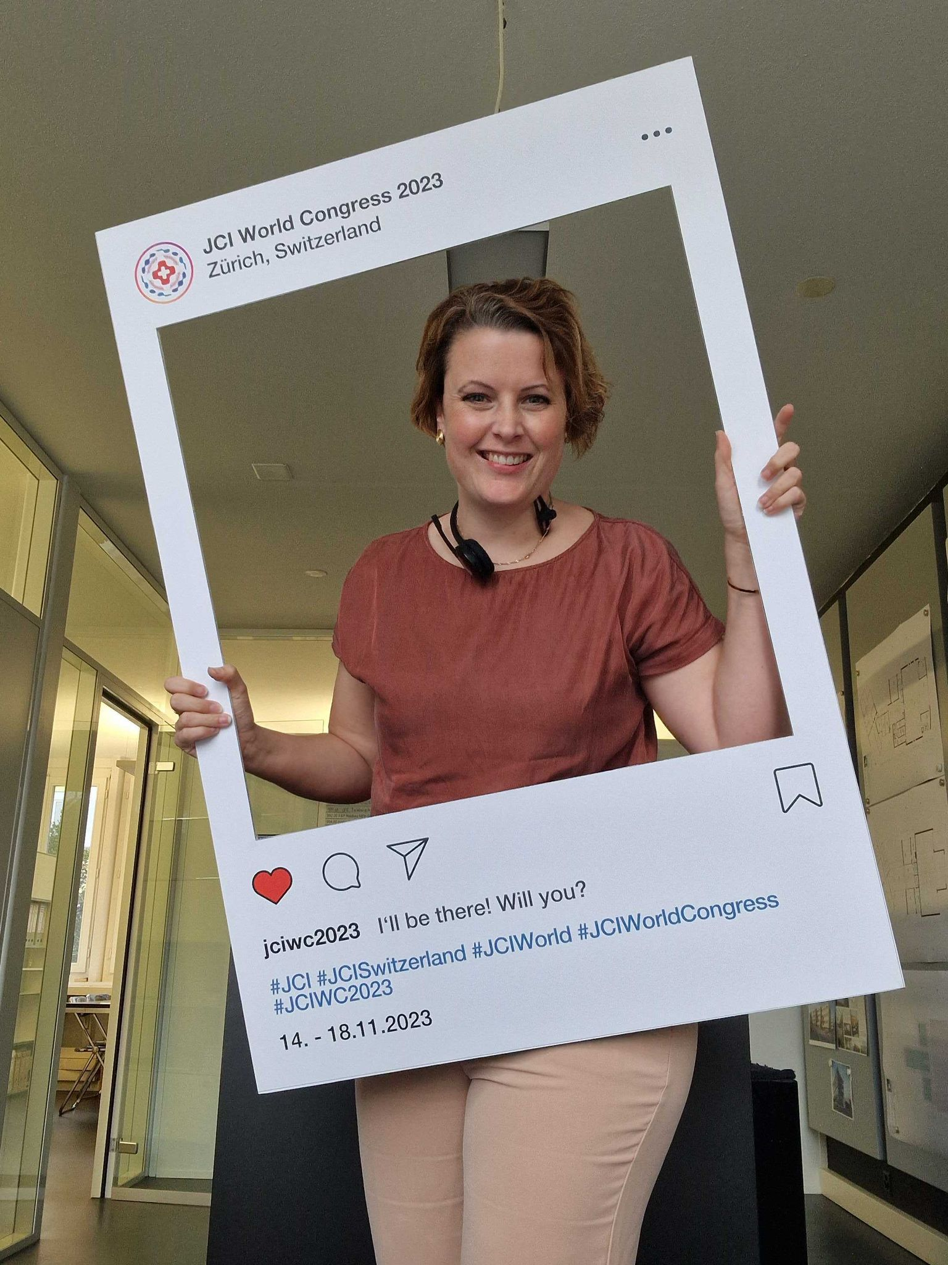
Become a JCI World Congress 2023 promoter!
Get your ticket
Take a selfie
Post your picture on Social Media and nominate (tag) 5 other members to get their ticket as well

Slide 31
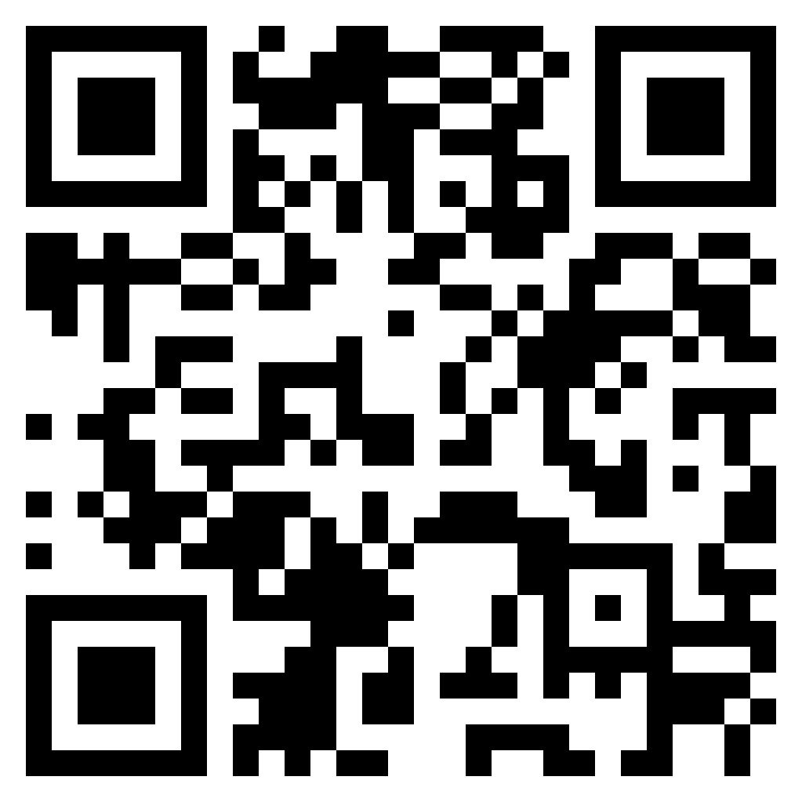
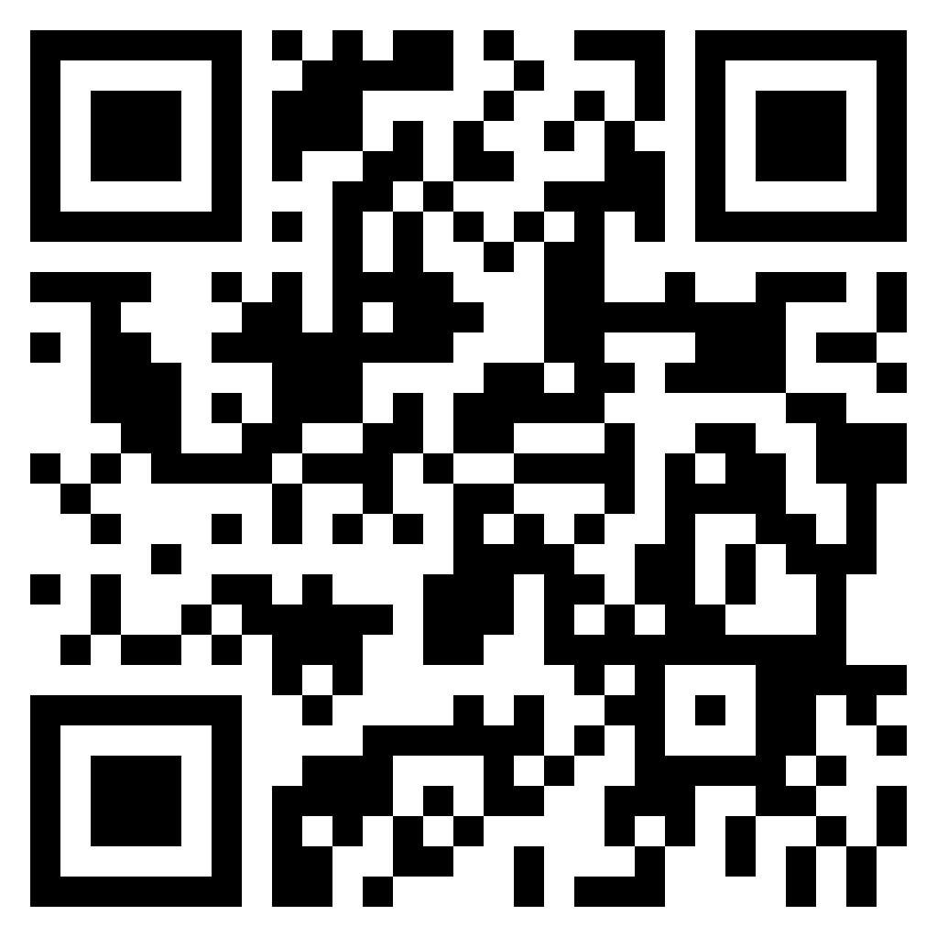
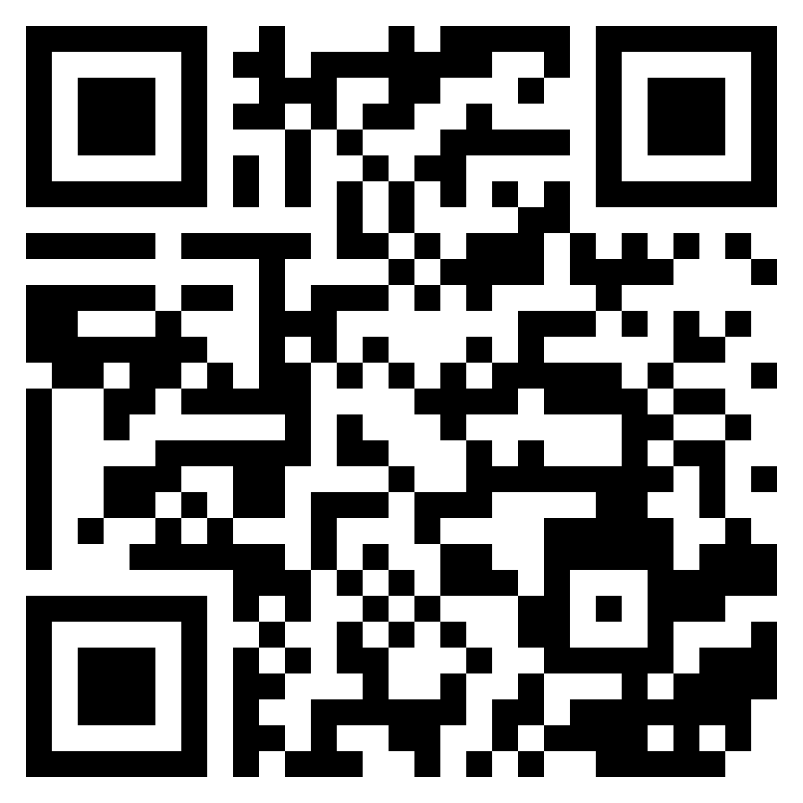
Reste informé!
Inscris-toi à la newsletter et reçois plus d'informations : www.jci-wc23.ch/
Reste en contact avec nous! Suis-nous sur Instagram @jciwc2023
Des Questions? hello@jci-wc23.ch
Facebook
Instagram
LinkedIn

Slide 32
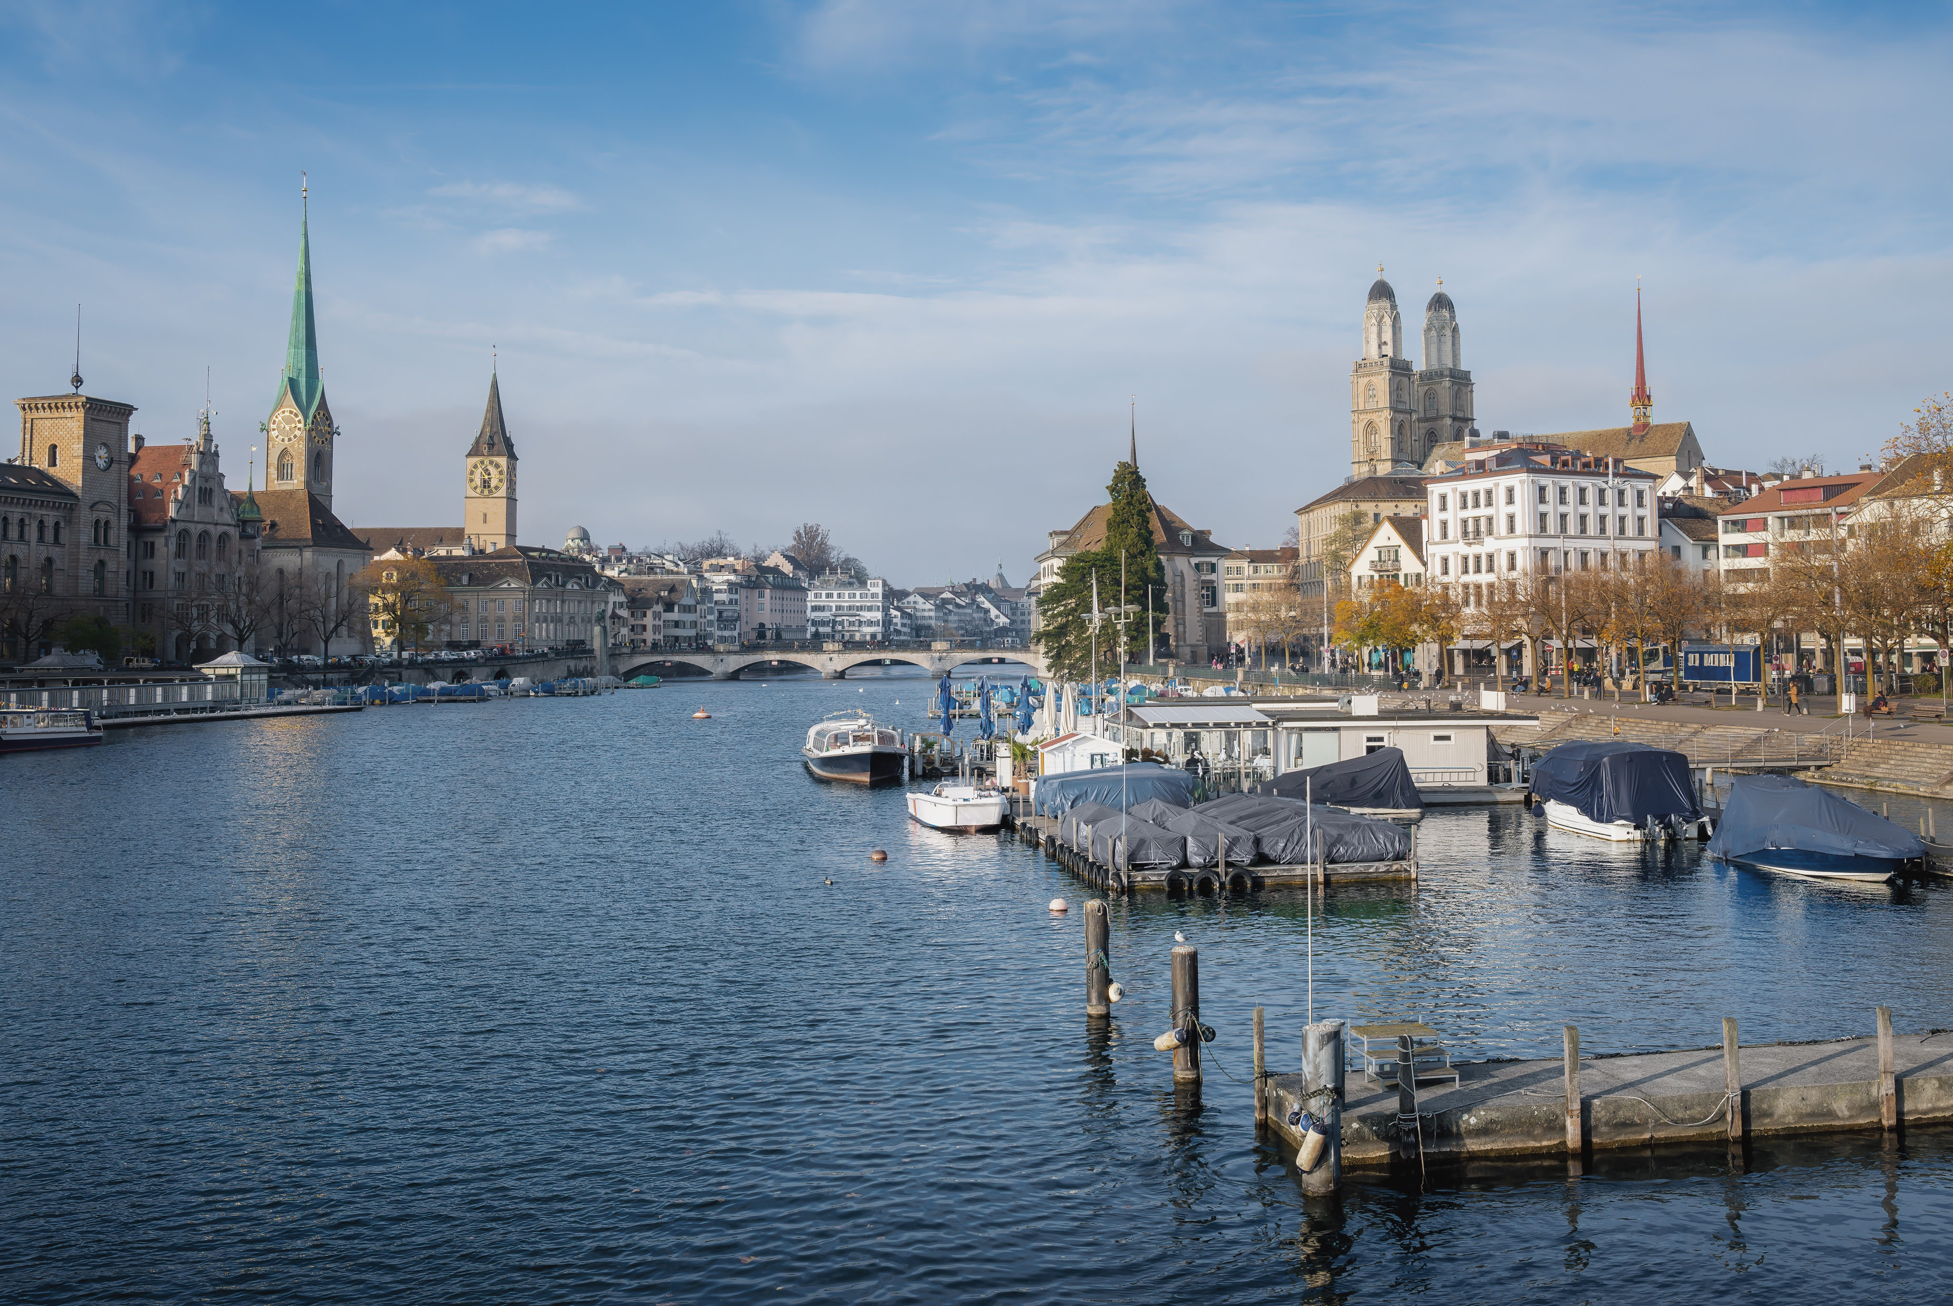
Team
09

Slide 33
COC Board
COC Director
Gloria Betschart
COC Deputy Director
Chris Baeriswyl
HR/Happiness Manager
Lars Kauer
Workforce & Volunteers
Marion Scherzinger & Nico Pietri
COC Team
with a total of 47 members
Legal Counsel
Pascal Zysset & Corina Peiry
Risk Manager
Jean Betrand Helip
Office Manager
Aylin Eisele
IT Support
Andreas Halbig
Finance Manager
Sven Steger & Kevin Villa Thomas Zenner
COC Advisor
Marco Hauger
Country Manager
David Schnetzer
National & International Bianca Mertens
Director Sponsoring Chris Baeriswyl (a.i.)
JB Helip
Director Program
André Hess
Director MarCom
Flavio Niederhauser Martina Häberle
Director Logistics
David Marti
Yannic Walther
Director Hospitality
Marine Giardina
Director Transport
Nikolina Mandic
KAM
GP Moll, Janos Niederhauser, Marcel Schuler, Reto Wirz, Sara Herder
JCI Senate
Tanja Geiger
Content & Text
Iris Isenschmid, Oliver Price
Infrastructure
Rooms / Hotels
Diane Rebstein
VIP Transport
open
Official
Simone Glarner
Graphic Design
Flavio Niederhauser
Technical Equipment
David Marti
F&B
Thierry Fuhrer
Transport Delegates
open
Supporter Wall
Beat Eberle
Trainings
Santo Costanza
Social Media
Julie Marti
Tradeshow
Tina Kramer
Check-In Messe & Welcome Desk
Olivia Lattmann
VISA
Hans Schubiger
Restaurants
open
Leisure
Matthias Berger
Web
Martina Häberle
GA
open
Partnerships & NGO
open
Merchandising
Martina Häberle
Security
open
Videoproduction
Luc Stähli, Mauro San Giorgio
Recycling
open

Slide 34
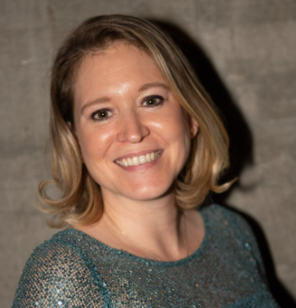
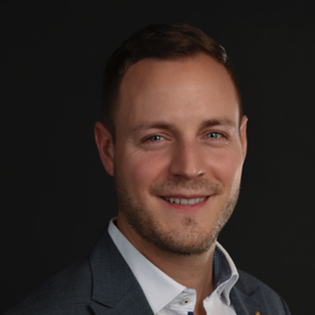
See you in Zürich!
COC Director
World Congress 2023
Gloria Betschart
LOM Luzern
COC Deputy Director
World Congress 2023
Chris Baeriswyl
LOM Zürich & Sense-See

Slide 35
SEE YOU IN ZÜRICH!
14. – 18. November 2023
jci-wc23.ch
#JCIWC2023

